Slide 1
AP CSP U.S. Bureau of Labor Data Activity Number 1
By Eddie Ceausu and Chase Compton

Slide 2
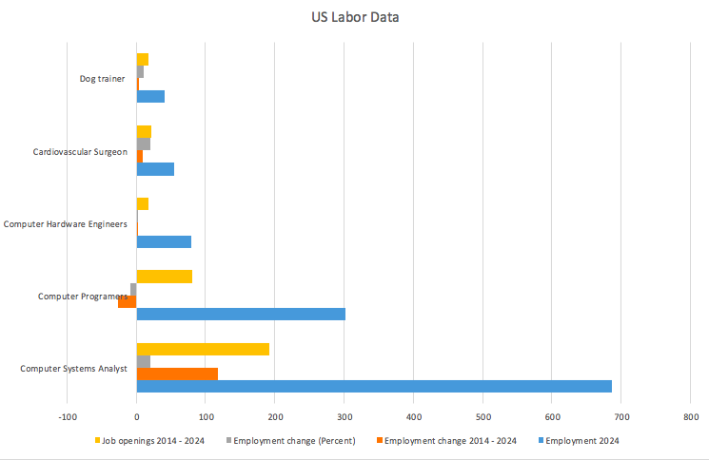

Slide 4
Cardiovascular surgeon
Requires a Medical degree.
Median Salary: 1 year after residency, $360,000, 6 years after residency $522,875
Expected growth by 2024: 21.5%

Slide 5
Computer systems analysts
Requires a bachelors degree
No on job training
Annual median salary: $85,000
By 2024 to be 686,000 job openings

Slide 6
Computer hardware engineer
Requires a Bachelors degree
Annual median salary: $111, 370
Job openings in 2024 expected to be 80,100.
No on the job training

Slide 7
Computer programmers
Requires a Bachelors
Expected Job openings in 2024 302,200
No on the job training
Annual median salary: $79,530

Slide 8
Dog Trainer
Requires a GED or equivalent
Requires on the job training
Annual salary: $26,610
Expected employment increase by 11.1% in 2024

Slide 9
Conclusion
I chose my top three choices based on: annual salary, school requirement, job security, and expected openings in 2024.
While my top choice required an extensive amount of schooling, the baby bloomer generation is aging creating more work for cardiovascular surgeons, and more job openings will occur in the field.

Slide 10
Work cited
http://www.payscale.com/research/US/Job=Cardiothoracic_Surgeon/Salary
http://www.payscale.com/research/US/Job=Dog_Trainer/Hourly_Rate
http://www.payscale.com/research/US/Job=Computer_Programmer/Salary
http://www.payscale.com/research/US/Job=Computer_Hardware_Engineer/Salary
http://www.payscale.com/research/US/Job=Computer_Systems_Analyst/Salary

